Slide 1
Angular JS Form Angular JS Form Validation
Web Programming

Slide 2
Angular JS Form
Forms in AngularJS provides data-binding and validation of input controls.
Input Controls
Input controls are the HTML input elements:
input elements
select elements
button elements
textarea elements

Slide 3
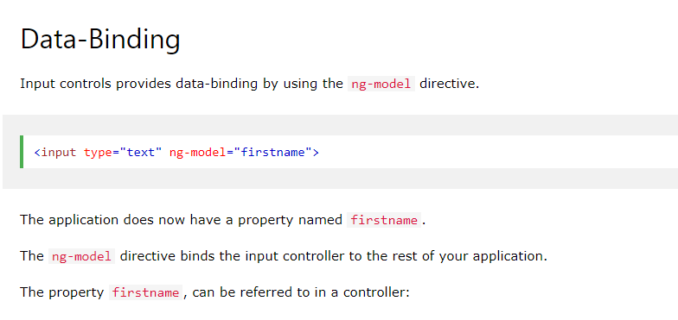
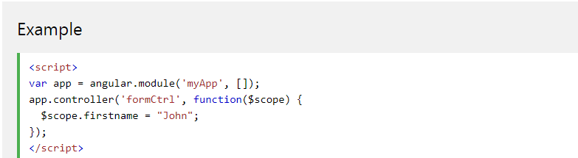

Slide 4
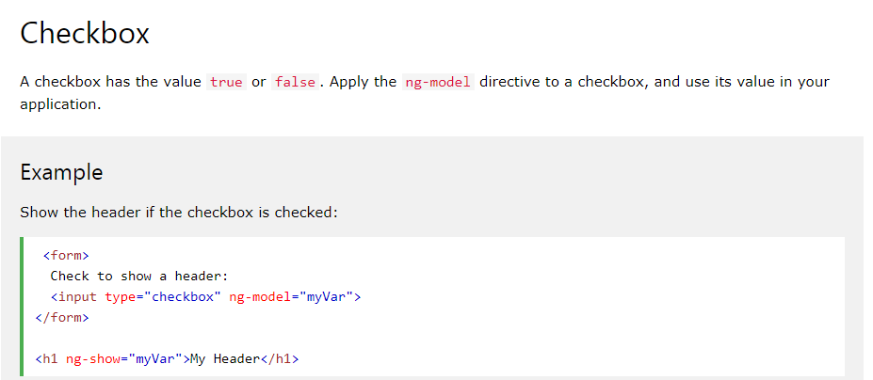

Slide 5
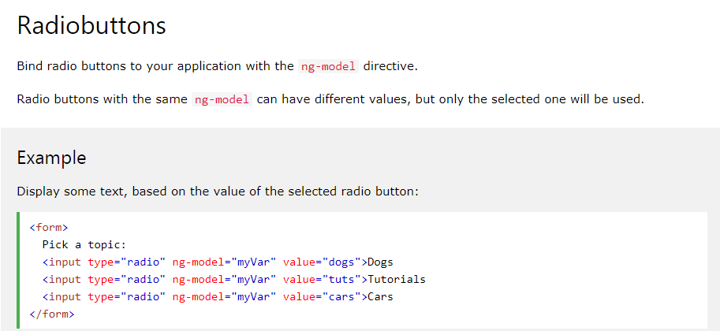

Slide 6
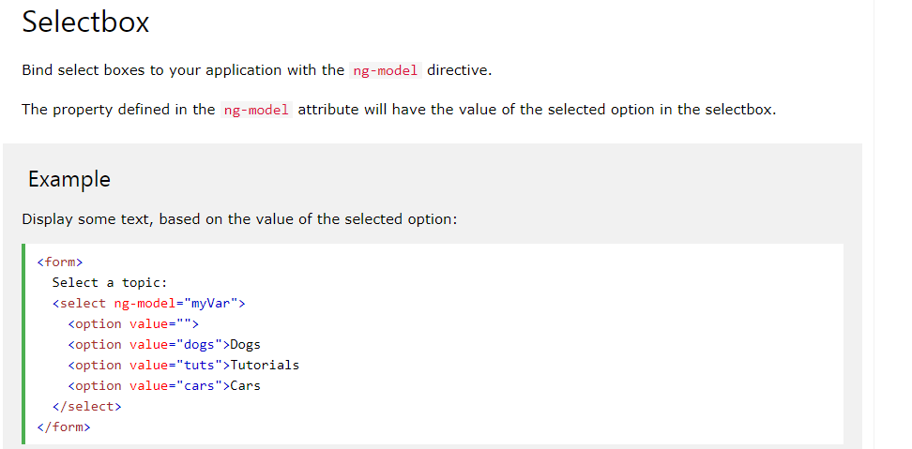

Slide 7
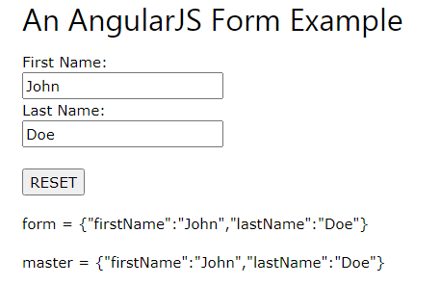
Design angular JS form to create two objects user and master. When user clicks on RESET button the default values are restored from master object.

